Slide 1
Fall Senior Parent Presentation
Class of 2023

Slide 2
Agenda
6:00-6:30 pm
Senior Activities - Jesse Armas, Activities Director
Premier Grad Products - Bob Sebring
USA Student Travel - Gwen Shackelford
WHS Yearbook - Sarah Nichols
Sober Grad Night - Jennyfer Osecheck
6:30-8:00pm
WHS Counseling Presentation - Amber Patterson
Sierra College - Alistair Turner
Closing - Mac Blate, Class of 2023 School Counselor

Slide 3
Senior Activities
Senior ball ticket sales: Week of April 17th
Senior activities sales: Week of May 15th
Senior ball: May 6th @ Masonic Temple in Sacramento
Grad week: May 30th – June 2nd
Senior checkout: May 30th in large gym
Senior Picnic: May 30th @ Beals Point Folsom Lake
Senior Panoramic Picture: May 31st @ 9:30am (tentative)
Senior Brunch: May 31st @ Lincoln Hills
Graduation is FRIDAY June 2nd @ 7:00 pm

Slide 4
Cap and Gown
Premier Grad Products Representative, Bob Sebring
Sept. 19th Bob will be on campus from 6:30 - 7:30 in the large gym lobby to take orders and questions.
To submit, you can physically hand it to Bob Sebring, turn in to the box in the student store or submit your order online.
Order by October 7th and have your items by the winter vacation!
premiergradproducts.com

Slide 5
Senior Trip 6/7 - 6/9
Gwen Shackelford, 916-997-9851
You will choose your room assignments in the spring at a meeting
Payment deadlines:
Currently you should have paid or will pay the $200 non-refundable deposit by Sept. 12th
Final balance is due Feb. 3rd, 2022
Total cost: $775
Bring payments to student store, mail to USA Student Travel or online.
Checks made payable to “USAST-Whitney HS”

Slide 6
Sober Grad Night 6/2/23
Registration Dates and Prices Yard Signs
Sept 12-18 $80 $20
Sept 19-Mar 20 $90 $25
Mar 21-May 15 $100 $25
May 16 - Jun 1 $110
Jun 2 @ the door $125
Info & Register: www.whitneysobergradnight.org
whssobergradnight@yahoo.com

Slide 7
Yearbook
Through January 1, 2022 order your yearbook through the student store webstore link OR from Jostens online
$75 and ($82 for engraved with name)
Get senior tribute info and ordering links here. Price goes up on the first of each month, and space is limited.
See next slide for what the steps look like.

Slide 8
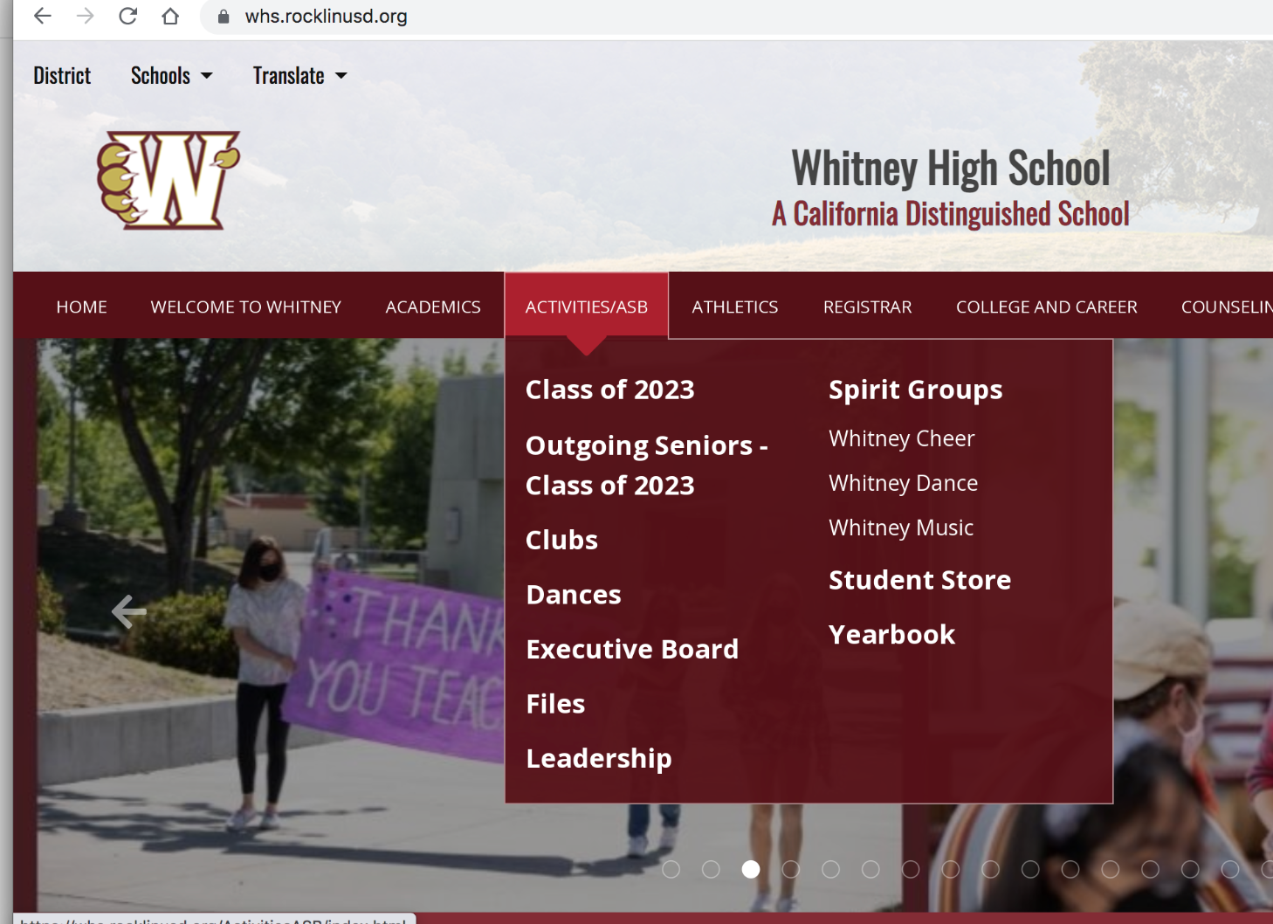
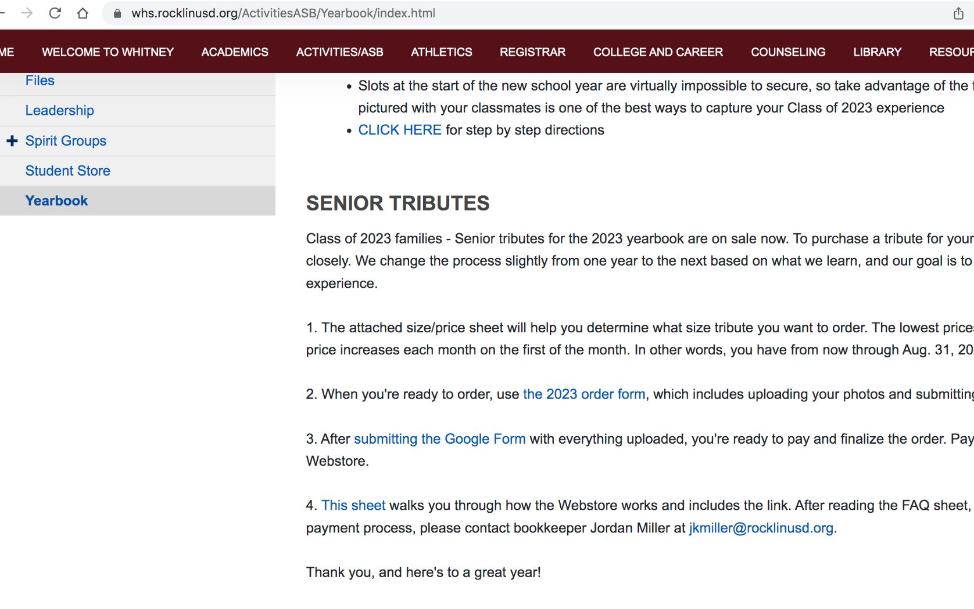
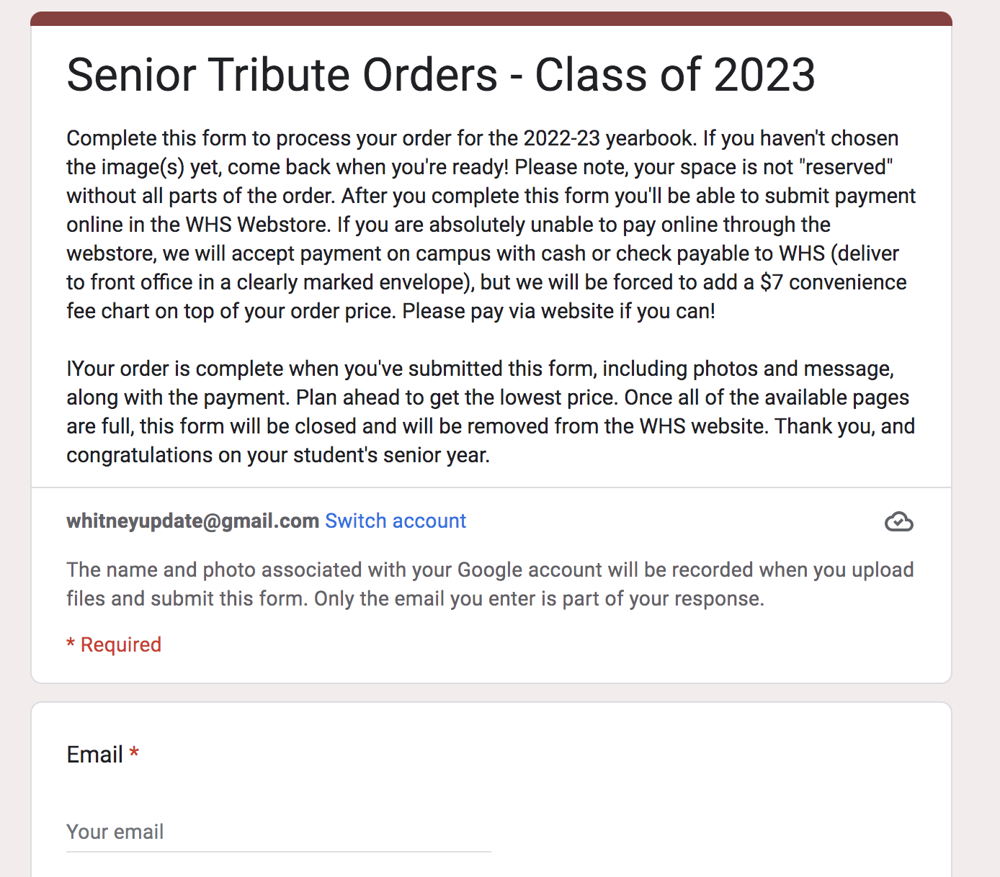
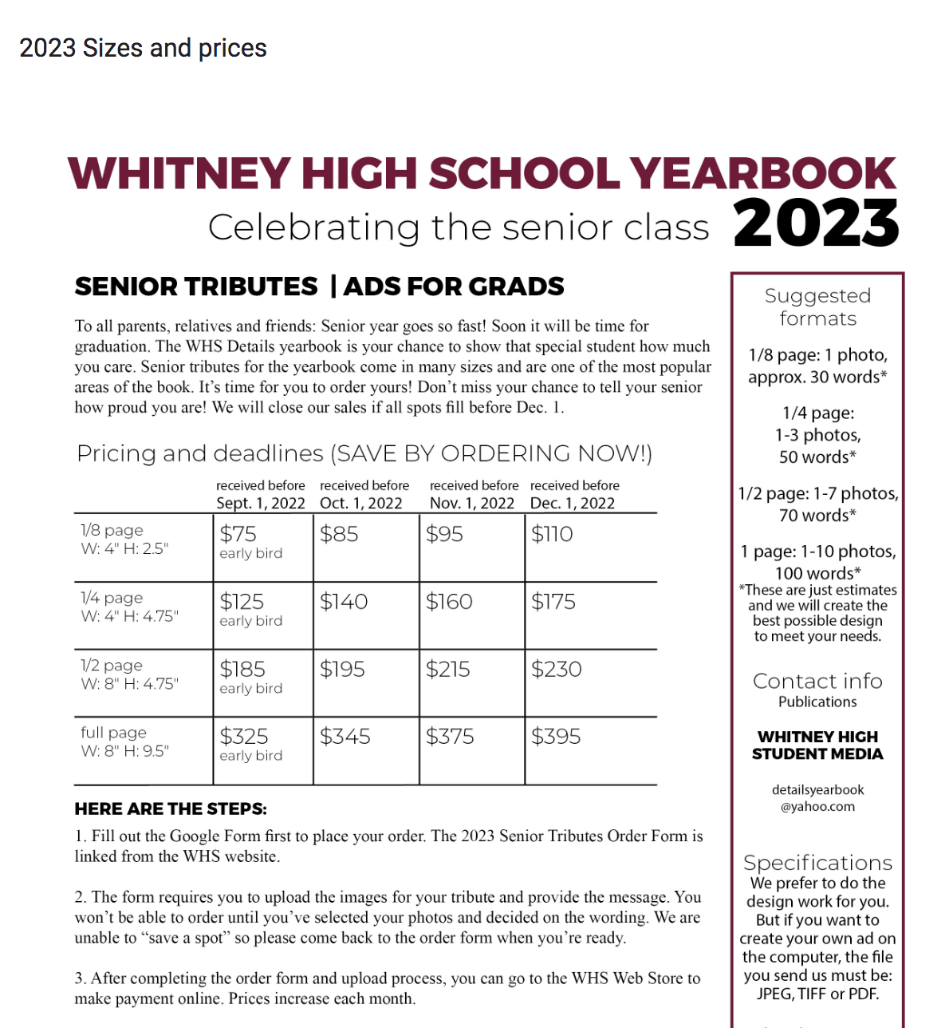
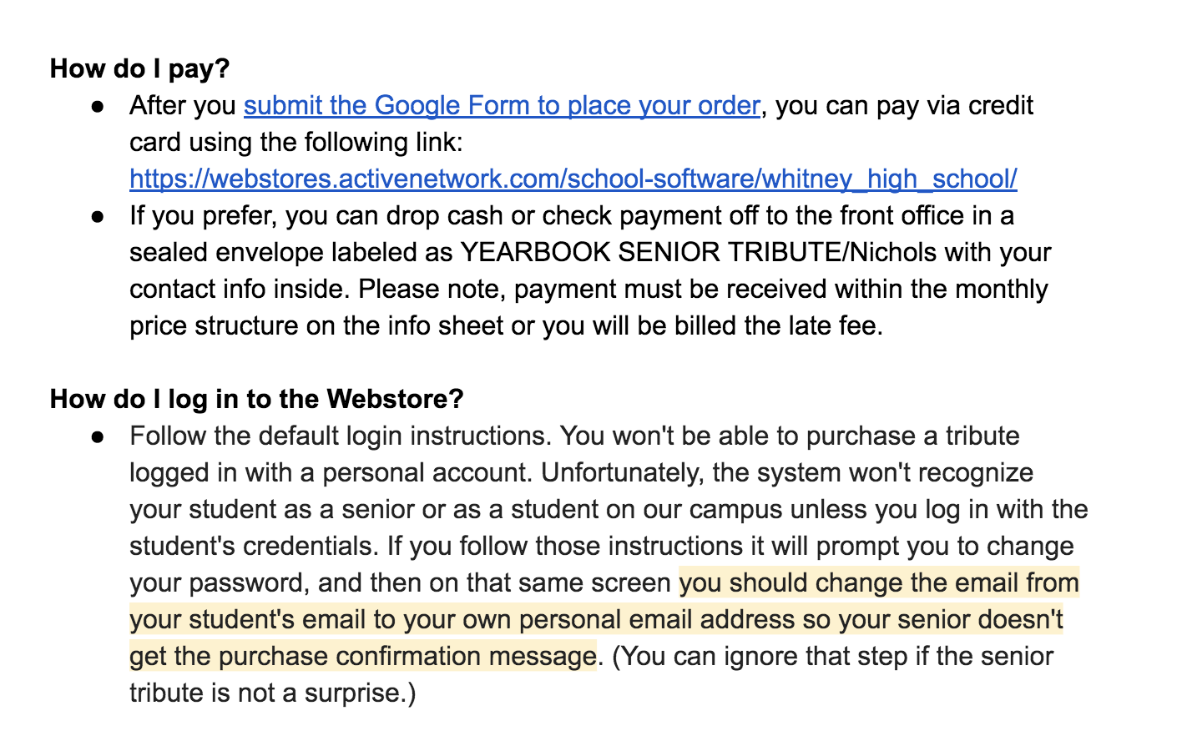
1
2
4
3
5

Slide 9
WHS COLLEGE AND CAREER
Amber Patterson: apatterson@rocklinusd.org
Rachel Lund: rlund@rocklinusd.org
Walk-in Hours: Mon-Thurs Break, PAWS, Lunch
Join the CCC Remind Group:
Text “@whitneyccc” to 81010

Slide 10
WHS COLLEGE AND CAREER
Senior Timeline
Fall Semester
Four-Year College Applications (UC & CSU due 11/30)
FAFSA (opens on Oct. 1 for 2023-2024 enrollment year)
Rep Visits in the CCC
Virtual Application Workshops Mondays at 1:30 pm
Scholarship Research/Apps (Assist-a-Grad in December)
Spring Semester
Four-Year College Applications (wrap up remaining)
Community College Applications
FAFSA (Complete by March for 2023-2024 enrollment year)
Continue Scholarship Research
Decision Day May 1

Slide 11
WHS COLLEGE AND CAREER
LIVE VIRTUAL WEBINARS
MONDAYS at 1:30PM
THROUGHOUT THE FALL
9/12: The Common Application
9/26: The UC Application
10/3: The CSU Application
10/10: Application Essay/ PIQ Writing
10/24: Curating the Application Activities Section
11/7: Financial Aid, Beyond the FAFSA

Slide 12
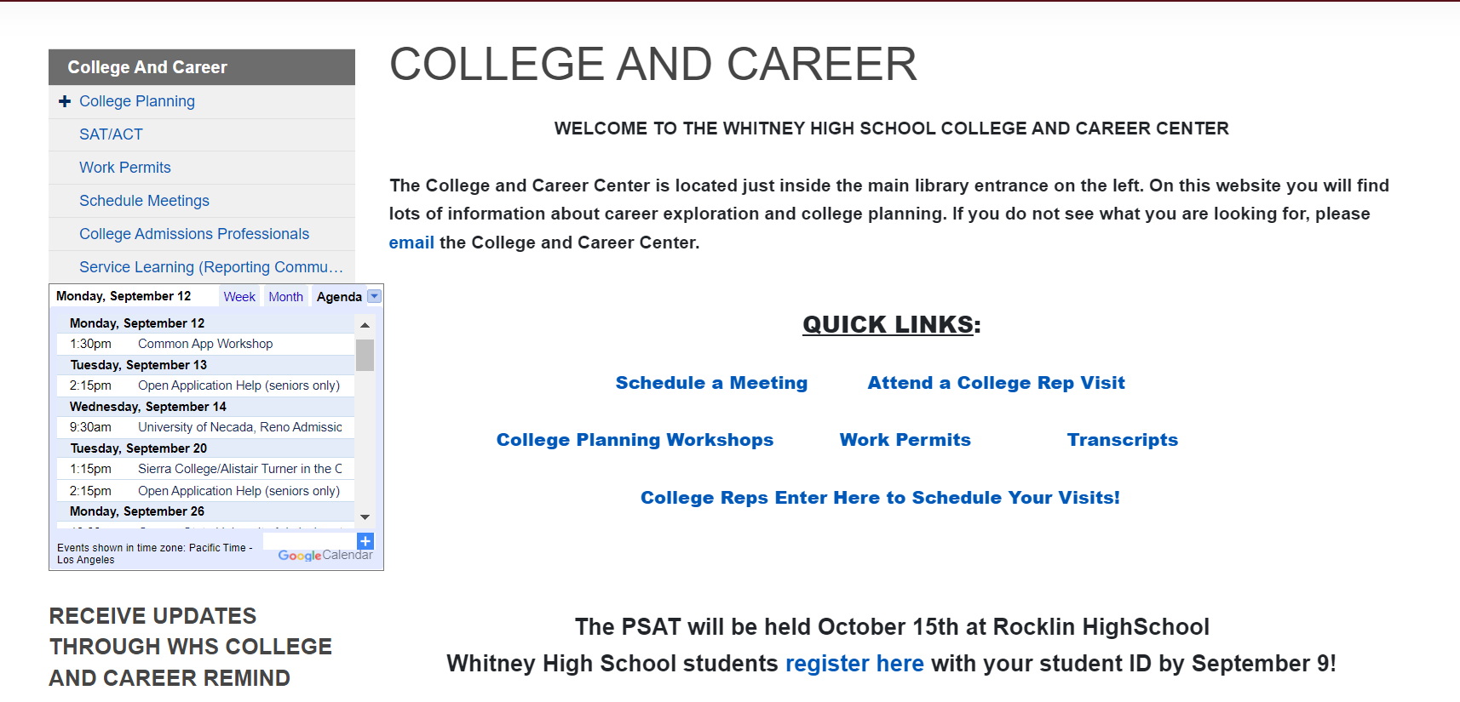
WHS COLLEGE AND CAREER

Slide 13
Why Community College?
Alistair Turner
Enrollment Specialist
Sierra College
aturner@sierracollege.edu

Slide 14
Find your interest at Sierra College

Slide 15
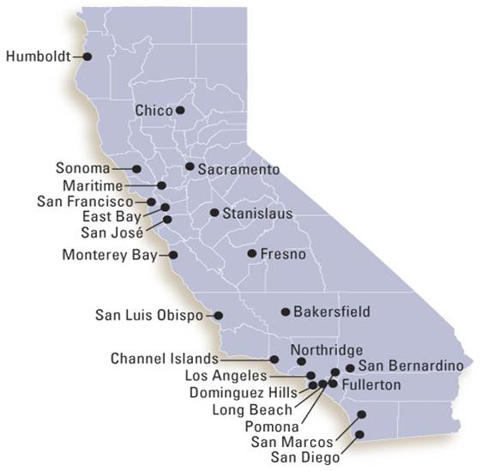
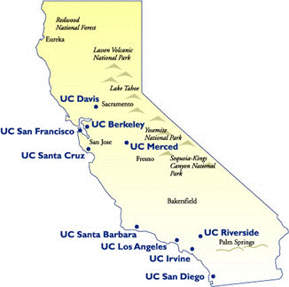
Transfer Students
Transfer
Notes:
Since the start of the pandemic, we have received increased questions regarding transferring after one year – most schools still require 2 years 60 units – a few exceptions such as SFSU, but popular schools for Sierra students such as Chico & Sacramento State need 2 years
Lot of discussion about standardized test – Sierra does not require it, also typically these schools have also never required transfer students to have SATs/ACT etc…
The GPA and Sierra driving force regarding transfer option – assist.org
Students will go to out of state / private in-state schools.
Top CSU – always CSUS – 400/500 students, followed by Chico, San Fran State, SJSU
Top UC – always UC Davis, followed by Berkeley

Slide 16
Two Years Free
Eligibility
Any first-time college student
Requirements
Complete the FAFSA/Dream Act application
Enroll full time (12 units required, 15 recommended)
Notes:
Students who completed AE/DE credits while in HS still eligible for the program
Must be a CA resident (anyone who attended HS for 3 years and graduate, yes).
Full time is important – we want students to finish in 2 years, whether that is degree and/or transfer
Due to changes in the state budget, funding may be limited for Two Years Free, so priority will go to those who complete their Financial Aid application by March 2".

Slide 17
Two Years Free
Two Years Free - covers tuition
What does Two Years Free not cover?
Books
Transportation
Living expenses
Complete a Financial Aid application
Determine what other assistance available to pay for expenses not covered by Two Years Free

Slide 18
Sierra Promise
Promise students
Enrollment assistance
Priority registration
Fall 2023
Connection to support programs
Transition Counselor
Financial Aid assistance
Notes:
Priority Reg – 1st semester, best choice of classes

Slide 19
WOMEN'S
Basketball
Beach Volleyball
Cross Country
Golf
Soccer
Softball
Swimming & Diving
Tennis
Track
Volleyball
Water Polo
MEN'S
Baseball
Basketball
Football
Golf
Swimming and Diving
Water Polo
Wrestling

Slide 20
College in High School
Earn College Credit
at Sierra College
at your High School

